Slide 1


Effects of Traditional and Western Environments on Prevalence of Type 2 Diabetes in Pima Indians in the United States of America.

Slide 2
Guided question
To evaluate the relationship among gravidity, obesity, and non-insulin-dependent mellitus in “Pregnant Pima Indians” living in the United States: Pima Indian women participated in a longitudinal epidemiologic study of diabetes were evaluated in both cross-sectional and longitudinal analyses.

Slide 3
OBJECTIVE:
Type 2 diabetes and obesity have genetic and environmental determinants. We studied the effects of different environments on these diseases in Pima Indians in Mexico and the U.S.

Slide 4
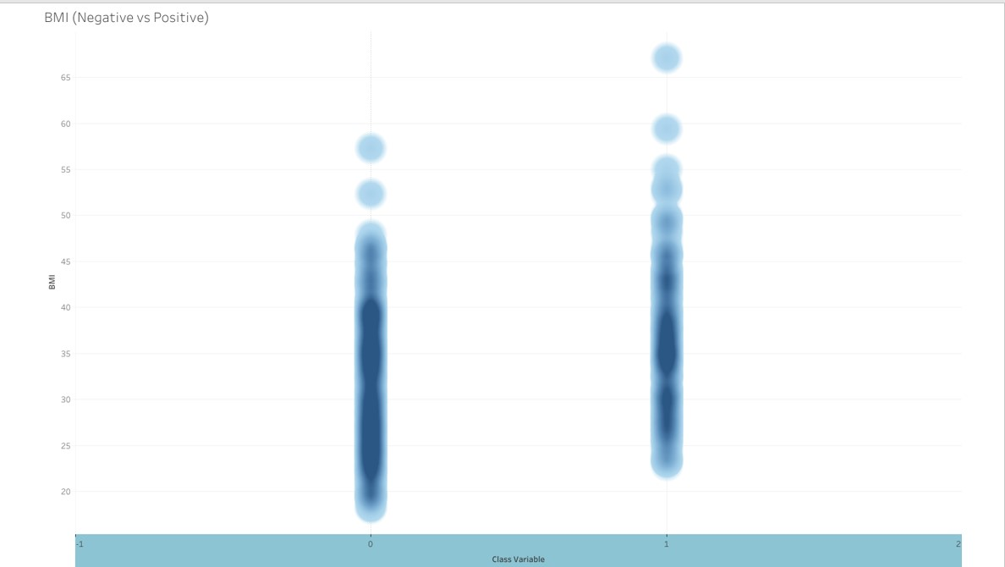
BMI (Negative vs Positive)
Microsoft makes it easy to insert a 3D Model! Simply go to the Insert Ribbon and click on the 3D Models option. Choose the option for online sources gallery (shown at the right). Select the model you wish to insert.
3D Models is a subscription-only feature. If you have an Office 365 subscription, the next slide shows you how it works in a new presentation.

Slide 5
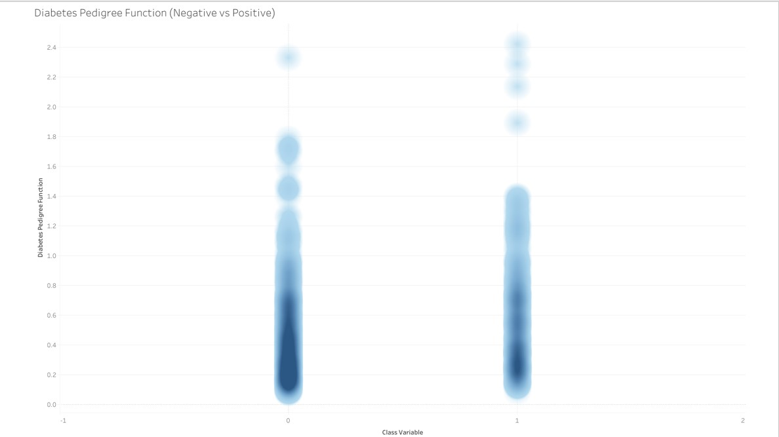
Diabetes Pedigree Function ( Negative vs Positive)
Microsoft makes it easy to insert a 3D Model! Simply go to the Insert Ribbon and click on the 3D Models option. Choose the option for online sources gallery (shown at the right). Select the model you wish to insert.
3D Models is a subscription-only feature. If you have an Office 365 subscription, the next slide shows you how it works in a new presentation.

Slide 6
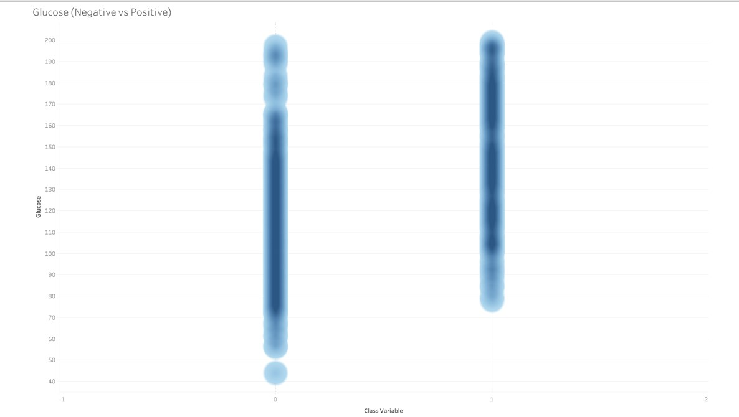
Glucose ( Negative vs Positive)
Microsoft makes it easy to insert a 3D Model! Simply go to the Insert Ribbon and click on the 3D Models option. Choose the option for online sources gallery (shown at the right). Select the model you wish to insert.
3D Models is a subscription-only feature. If you have an Office 365 subscription, the next slide shows you how it works in a new presentation.

Slide 7
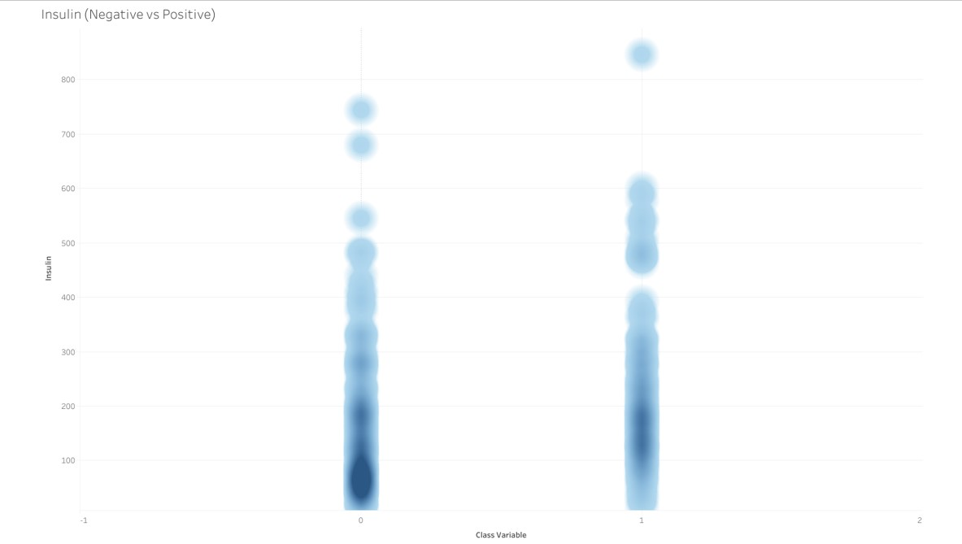
Insulin ( Negative vs Positive)
Microsoft makes it easy to insert a 3D Model! Simply go to the Insert Ribbon and click on the 3D Models option. Choose the option for online sources gallery (shown at the right). Select the model you wish to insert.
3D Models is a subscription-only feature. If you have an Office 365 subscription, the next slide shows you how it works in a new presentation.

Slide 8
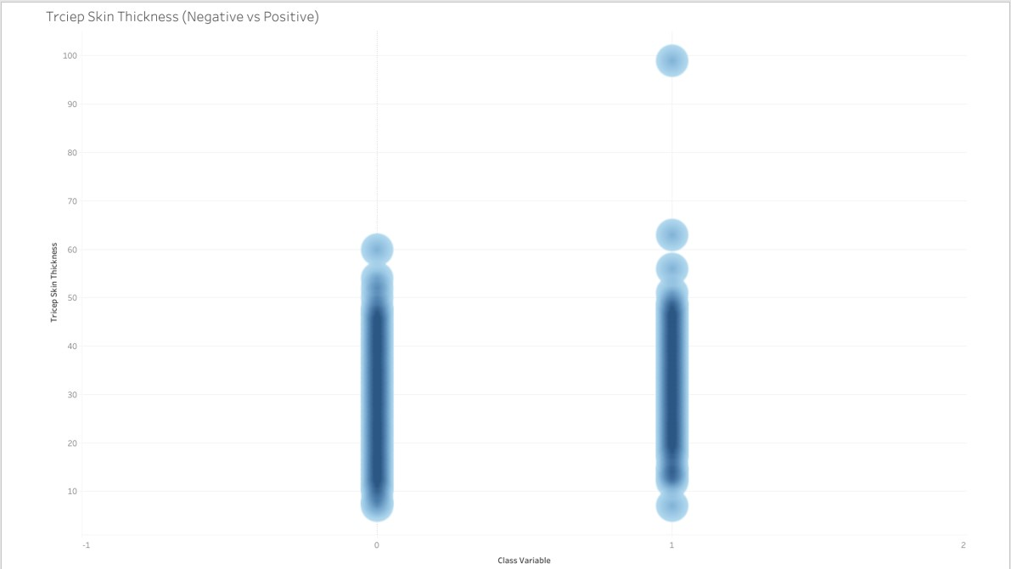
Triceps Skin Thickness (Negative vs Positive)
Microsoft makes it easy to insert a 3D Model! Simply go to the Insert Ribbon and click on the 3D Models option. Choose the option for online sources gallery (shown at the right). Select the model you wish to insert.
3D Models is a subscription-only feature. If you have an Office 365 subscription, the next slide shows you how it works in a new presentation.

Slide 9
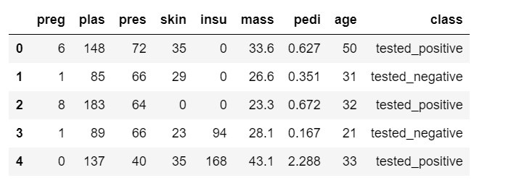
Triceps Skin Thickness (Negative vs Positive)
Microsoft makes it easy to insert a 3D Model! Simply go to the Insert Ribbon and click on the 3D Models option. Choose the option for online sources gallery (shown at the right). Select the model you wish to insert.
3D Models is a subscription-only feature. If you have an Office 365 subscription, the next slide shows you how it works in a new presentation.

Slide 10
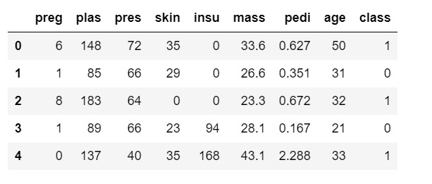

Triceps Skin Thickness (Negative vs Positive)
Microsoft makes it easy to insert a 3D Model! Simply go to the Insert Ribbon and click on the 3D Models option. Choose the option for online sources gallery (shown at the right). Select the model you wish to insert.
3D Models is a subscription-only feature. If you have an Office 365 subscription, the next slide shows you how it works in a new presentation.

Slide 11
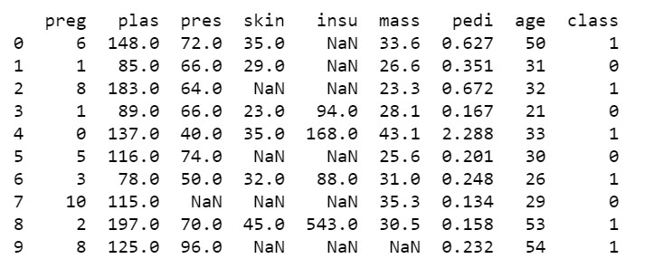
Triceps Skin Thickness (Negative vs Positive)
Microsoft makes it easy to insert a 3D Model! Simply go to the Insert Ribbon and click on the 3D Models option. Choose the option for online sources gallery (shown at the right). Select the model you wish to insert.
3D Models is a subscription-only feature. If you have an Office 365 subscription, the next slide shows you how it works in a new presentation.

Slide 12
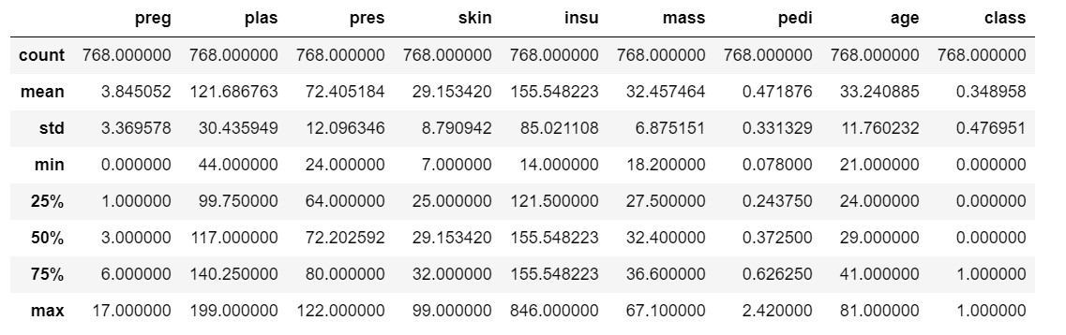
Triceps Skin Thickness (Negative vs Positive)
Microsoft makes it easy to insert a 3D Model! Simply go to the Insert Ribbon and click on the 3D Models option. Choose the option for online sources gallery (shown at the right). Select the model you wish to insert.
3D Models is a subscription-only feature. If you have an Office 365 subscription, the next slide shows you how it works in a new presentation.

Slide 13
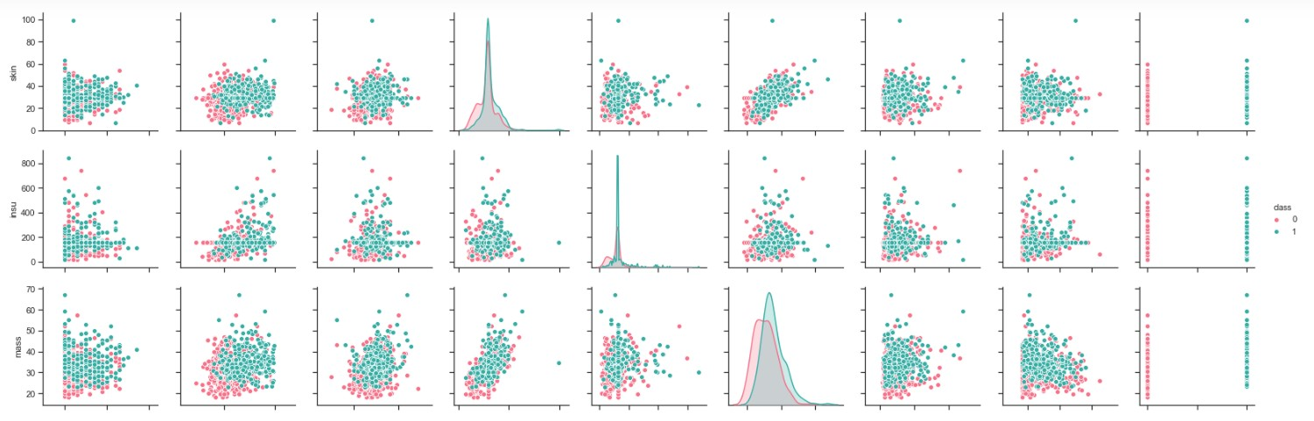
Triceps Skin Thickness (Negative vs Positive)

Slide 14
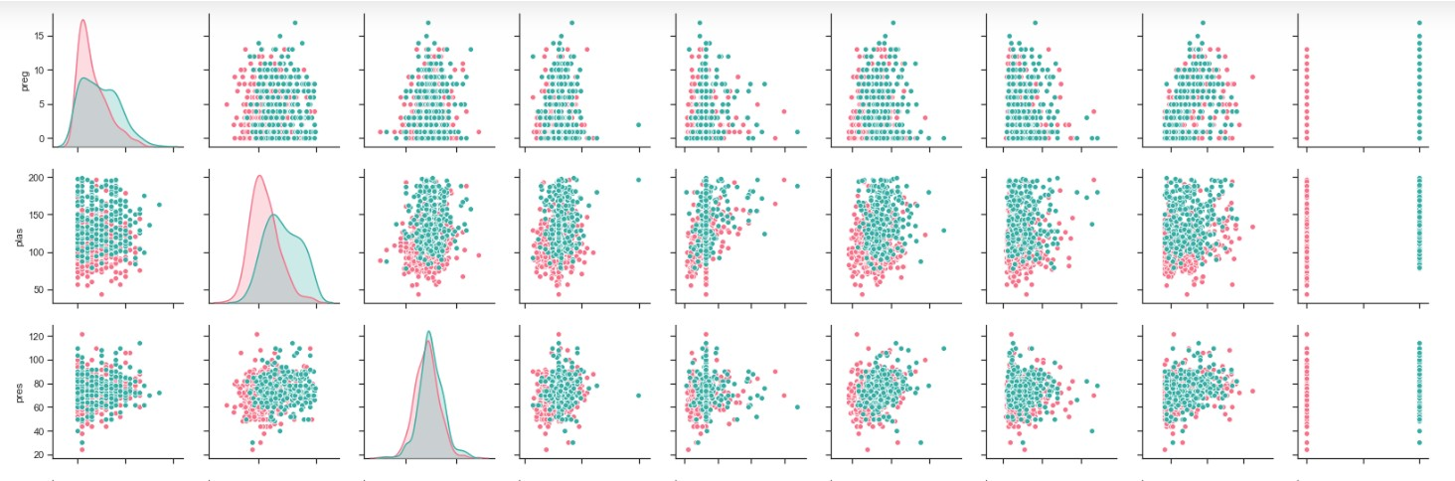
Triceps Skin Thickness (Negative vs Positive)

Slide 15
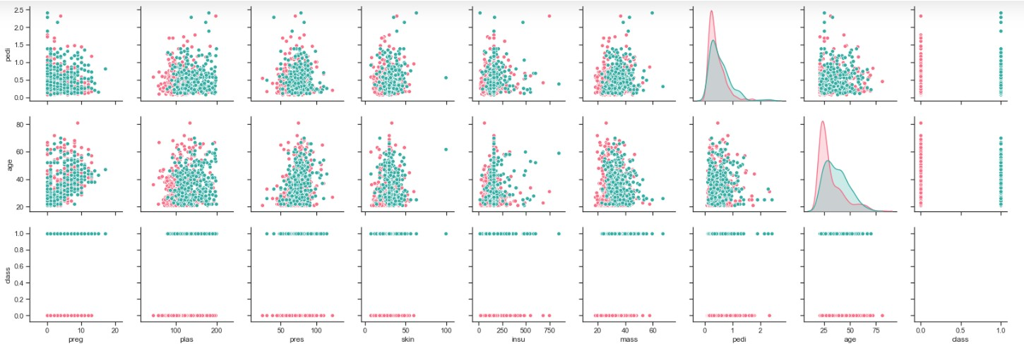
Triceps Skin Thickness (Negative vs Positive)

Slide 16
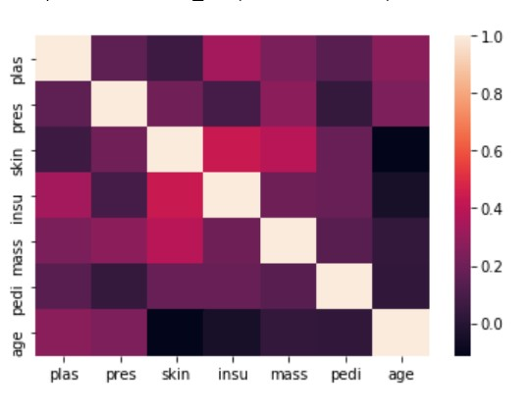
Triceps Skin Thickness (Negative vs Positive)
Using Heatmap to show the Dataset.

Slide 17



CONCLUSIONS:
The much lower prevalence of type 2 diabetes and obesity in the Pima Indians in Mexico than in the U.S. indicates that even in populations genetically prone to these conditions, their development is determined mostly by environmental circumstances, thereby suggesting that type 2 diabetes is largely preventable. This study provides compelling evidence that changes in lifestyle associated with Westernization play a major role in the global epidemic of type 2 diabetes.
Visit Our GitHub blog

